Slide 1
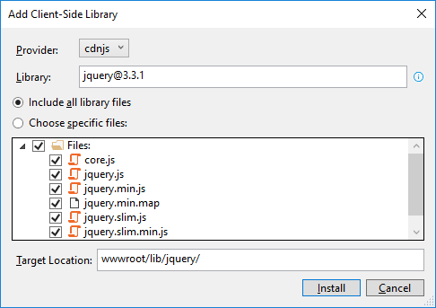
How to add the Bootstrap and jQuery libraries
Start Visual Studio and open a project. In the Solution Explorer, expand the wwwroot/lib folder and delete any old Bootstrap or jQuery libraries.
In the Solution Explorer, right-click on the project name and select the Add→Client-Side Library item.
In the dialog box that appears, “jquery@”, “popper.js”, “jquery-validate”, and “twitter-bootstrap”(but change the target location to “www/lib/bootstrap” for this one).

Slide 2
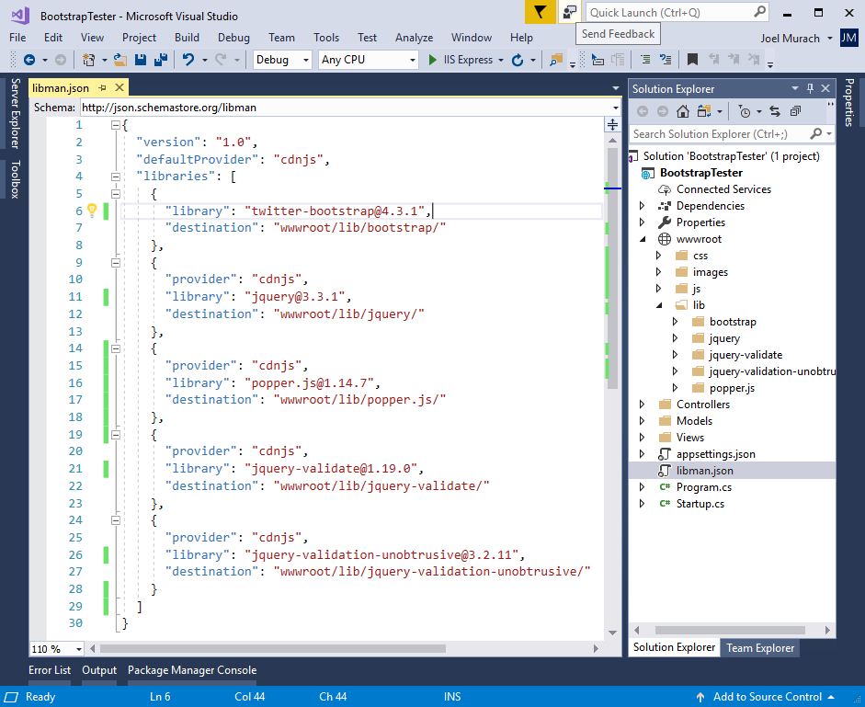
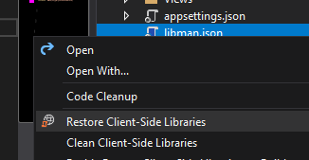
The libman.json file for the client-side libraries
Clean to delete
Restore to restore
(-> restores based on the dependencies written on the code)

Slide 3
A Razor layout that enables client-side libraries
<!DOCTYPE html>
<html>
<head>
<meta name="viewport" content="width=device-width" />
<title>@ViewData["Title"]</title>
<link rel="stylesheet"
href="~/lib/bootstrap/css/bootstrap.min.css" />
<link rel="stylesheet" href="~/css/custom.css" />
<script src="~/lib/jquery/jquery.min.js"></script>
<script src="~/lib/popper.js/popper.min.js"></script>
<script src="~/lib/bootstrap/js/bootstrap.min.js"></script>
<script src="~/lib/jquery-validate/
jquery.validate.min.js"></script>
<script src="~/lib/jquery-validation-unobtrusive/
jquery.validate.unobtrusive.min.js"></script>
</head>
<body>
@RenderBody()
</body>
</html>

Slide 4
An extra directory that may be included by the MVC template
<link rel="stylesheet"
href="~/lib/bootstrap/dist/css/bootstrap.min.css" />

Slide 5
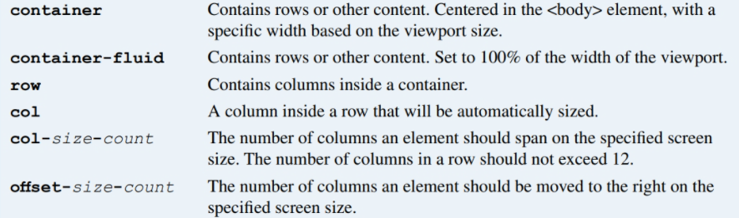
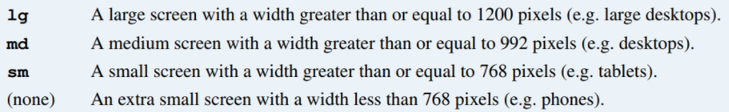
Valid Bootstrap class values
Valid size values

Slide 6
The HTML for a grid
<main class="container">
<div class="row">
<div class="col-12">Column 1</div>
<div class="col-12">Column 2</div>
</div>
<div class="row">
<div class="col-md-4">Column 1</div>
<div class="col-md-8">Column 2</div>
</div>
<div class="row">
<div class="col-md-4 col-sm-6">Column 1</div>
<div class="col-md-8 col-sm-6">Column 2</div>
</div>
</main>
An element that is moved one column to the right on medium screens
<div class="col-md-4 offset-md-1">
This element is offset by one column
</div>

Slide 7
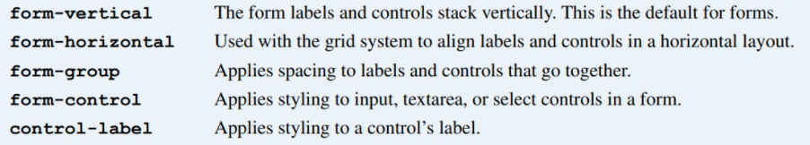
Bootstrap CSS classes for forms

Slide 8
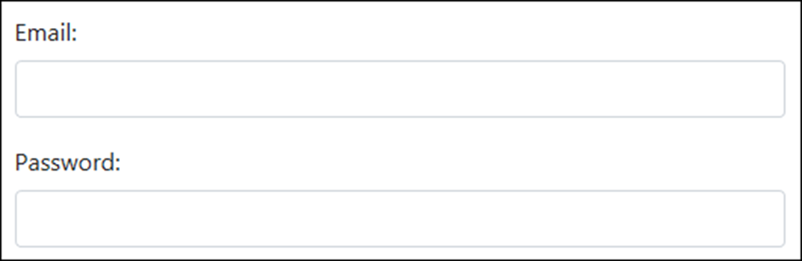
The HTML for the form in vertical layout
<form asp-action="Login" method="post">
<div class="form-group">
<label for="email">Email:</label>
<input type="email" id="email" class="form-control" />
</div>
<div class="form-group">
<label for="pwd">Password:</label>
<input id="pwd" type="password" class="form-control" />
</div>
</form>

Slide 9
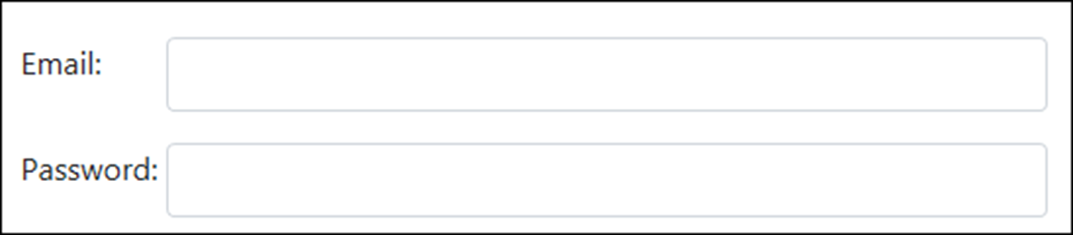
The HTML for the form in horizontal layout
<form asp-action="Login" method="post">
<div class="form-group row">
<label for="email" class="col-sm-2">Email:</label>
<div class="col-sm-10">
<input type="email" id="email" class="form-control" />
</div>
</div>
<div class="form-group row">
<label for="pwd" class="col-sm-2">Password:</label>
<div class="col-sm-10">
<input type="password" id="pwd" class="form-control" />
</div>
</div>
</form>

Slide 10
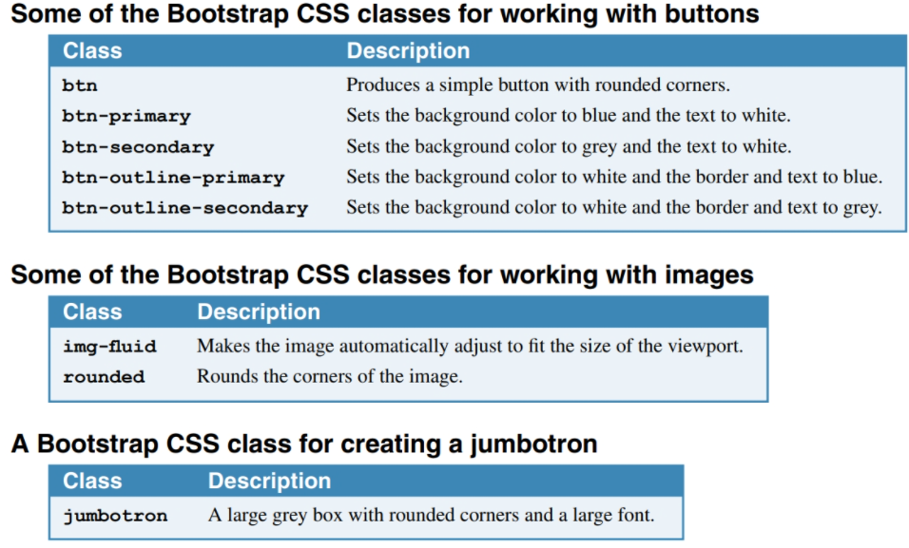

Slide 11
The HTML for the jumbotron, image, and buttons
<div class="container">
<header class="jumbotron">
<img id="logo" alt="Murach logo"
src="~/images/MurachLogo.jpg"
class="img-fluid rounded" />
</header>
<main>
<form asp-action="Index" method="post">
<span class="mr-2">I accept the terms for this site:
</span>
<button type="submit" class="btn btn-primary">
Yes
</button>
<button id="btnNo" class="btn btn-outline-secondary">
No
</button>
</form>
</main>
</div>

Slide 12
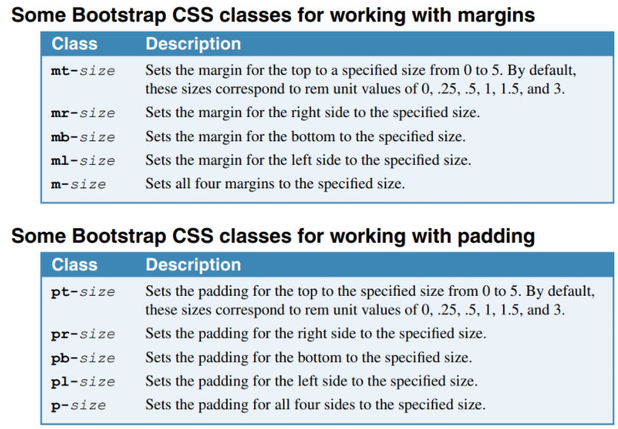

Slide 13
The code for the Index view (part 1)
@model FutureValueModel
@{
ViewBag.Title = "Future Value Calculator";
}
<div class="container">
<header class="jumbotron">
<img id="logo" alt="Murach logo"
src="~/images/MurachLogo.jpg"
class="img-responsive rounded" />
<h1 class="mt-3">@ViewBag.Title</h1>
</header>
<main>
<form asp-action="Index" method="post">
<div class="row form-group">
<label asp-for="MonthlyInvestment"
class="col-sm-3">Monthly Investment: </label>
<div class="col-sm-3">
<input asp-for="MonthlyInvestment"
class="form-control" />
</div>
<span asp-validation-for="MonthlyInvestment"
class="col text-danger"></span>
</div>

Slide 14
The code for the Index view (part 2)
<div class="row form-group">
<label asp-for="YearlyInterestRate"
class="col-sm-3">Yearly Interest Rate:
</label>
<div class="col-sm-3">
<input asp-for="YearlyInterestRate"
class="form-control" />
</div>
<span asp-validation-for="YearlyInterestRate"
class="col text-danger"></span>
</div>
<div class="row form-group">
<label asp-for="Years" class="col-sm-3">
Number of Years: </label>
<div class="col-sm-3">
<input asp-for="Years" class="form-control" />
</div>
<span asp-validation-for="Years"
class="col text-danger"></span>
</div>

Slide 15
The code for the Index view (part 3)
<div class="row form-group">
<label class="col-sm-3">Future Value:</label>
<div class="col-sm-3">
<input value="@ViewBag.FutureValue" readonly
class="form-control" />
</div>
</div>
<div class="row form-group">
<div class="col offset-sm-3">
<button type="submit" class="btn btn-primary">
Calculate</button>
<a asp-action="Index"
class="btn btn-outline-secondary">Clear</a>
</div>
</div>
</form>
</main>
</div>

Slide 16
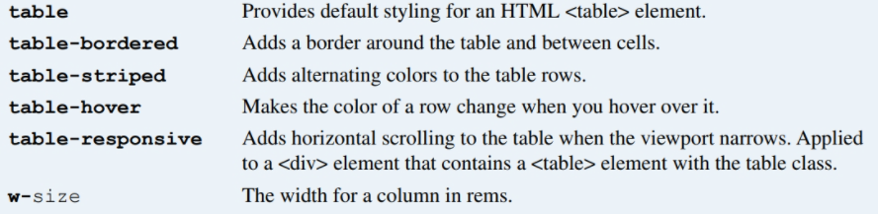
CSS classes for working with HTML tables
<table class="table table-striped table-bordered table-hover">...

Slide 17
The HTML for the table
<table class="table">
<thead>
<tr>
<th>Department</th>
<th>Phone Number</th>
<th>Extension</th></tr>
</thead>
<tbody>
<tr>
<td>General</td>
<td>555-555-5555</td>
<td>1</td></tr>
<tr>
<td>Customer Service</td>
<td>555-555-5556</td>
<td>2</td></tr>
<tr>
<td>Billing and Accounts</td>
<td>555-555-5557</td>
<td>3</td></tr>
</tbody>
</table>

Slide 18
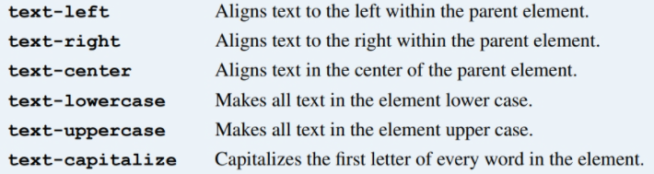
Common CSS classes for text

Slide 19
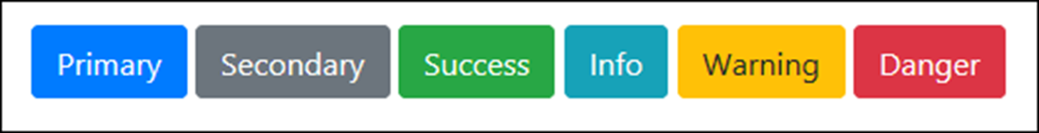
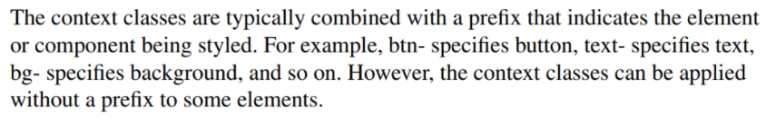
The context classes available to most elements
Class Default color
primary Dark blue
secondary Gray
success Green
info Light blue
warning Orange
danger Red
light White
dark Gray
btn-primary
text-success
bg-warning

Slide 20
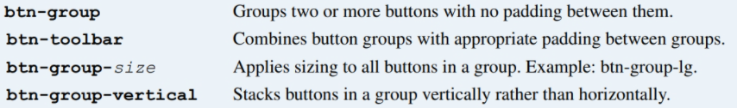
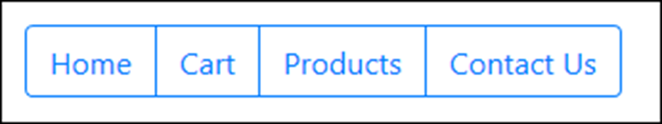
Common CSS classes for creating button groups
The HTML for the button group
<div class="btn-group" role="group"
aria-label="Button group">
<a href="/" class="btn btn-outline-primary">Home</a>
<a href="/cart" class="btn btn-outline-primary">
Cart</a>
<a href="/products" class="btn btn-outline-primary">
Products</a>
<a href="/contact-us" class="btn btn-outline-primary">
Contact Us</a>
</div>

Slide 21

A toolbar with two button groups
The HTML for the button groups
<div class="btn-toolbar" role="toolbar"
aria-label="Toolbar with groups">
<div class="btn-group mr-2" role="group"
aria-label="First group">
<a href="/" class="btn btn-outline-primary">Home</a>
<a href="/Cart" class="btn btn-outline-primary">Cart</a>
</div>
<div class="btn-group" role="group" aria-label="Second group">
<a href="/products" class="btn btn-outline-primary">
Products</a>
<a href="/contact-us" class="btn btn-outline-primary">
Contact Us</a>
</div>
</div>

Slide 22
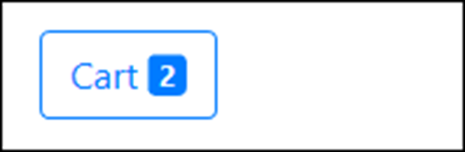
A button with a badge
The HTML for the button
<a href="/cart" class="btn btn-outline-primary">
&nbsp;Cart&nbsp;
<span class="badge badge-primary">2</span>
</a>

Slide 23
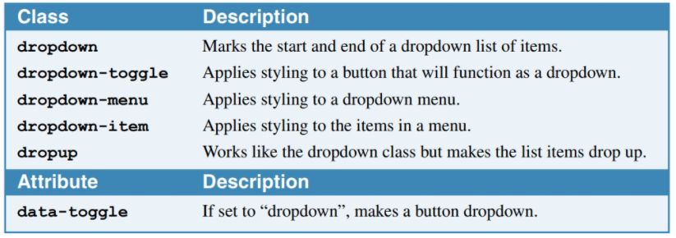
CSS classes for creating button dropdowns

Slide 24
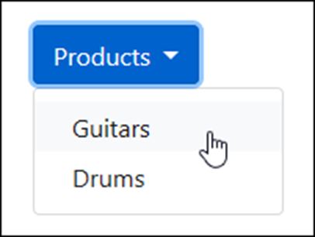
A button dropdown
The HTML for the button dropdown
<div class="dropdown">
<button type="button" class="btn btn-primary dropdown-toggle"
id="productsDropdown" data-toggle="dropdown"
aria-haspopup="true" aria-expanded="false">Products
</button>
<div class="dropdown-menu" aria-labelledby="productsDropdown">
<a class="dropdown-item"
href="/product/list/guitars">Guitars</a>
<a class="dropdown-item"
href="/product/list/drums">Drums</a>
</div>
</div>

Slide 25
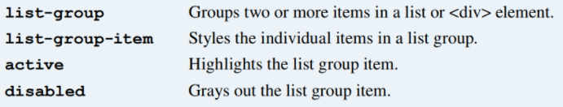
Common CSS classes for creating list groups

Slide 26
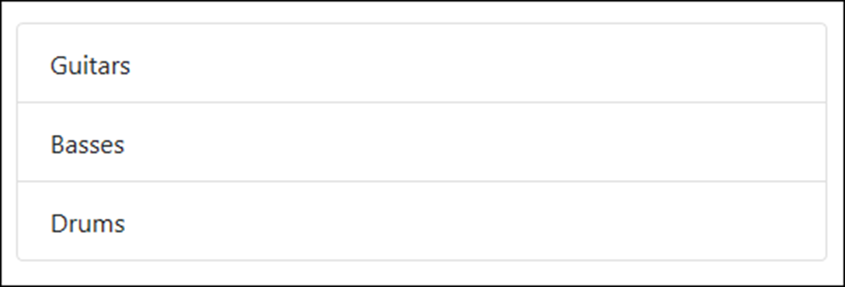
A basic list group
The HTML for the list group
<ul class="list-group">
<li class="list-group-item">Guitars</li>
<li class="list-group-item">Basses</li>
<li class="list-group-item">Drums</li>
</ul>

Slide 27
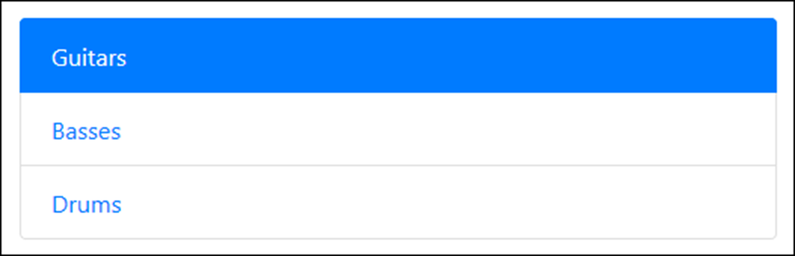
Another basic list group with an active item
The HTML for the list group
<div class="list-group">
<a href="/guitars" class="list-group-item active">
Guitars</a>
<a href="/basses" class="list-group-item">Basses</a>
<a href="/drums" class="list-group-item">Drums</a>
</div>

Slide 28
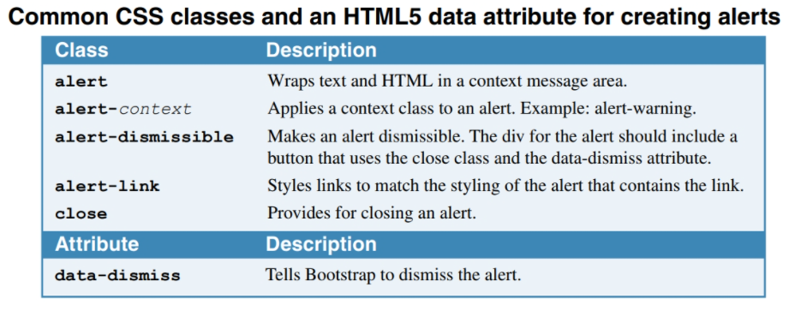

Slide 29
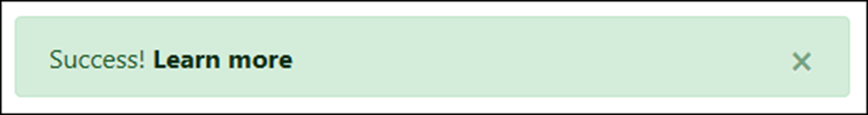
A dismissible alert with a link
The HTML for the alert
<div class="alert alert-success alert-dismissible">
<button class="close" data-dismiss="alert">
&times;
</button>
Success! <a href="#" class="alert-link">
Learn more</a>
</div>

Slide 30
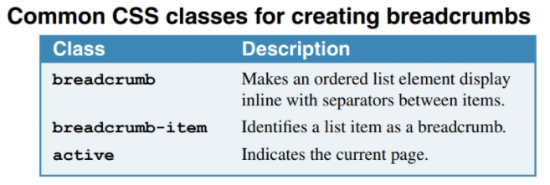

Slide 31
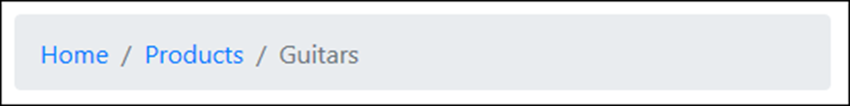
A breadcrumb with three segments
The HTML for the breadcrumb
<nav aria-label="breadcrumb">
<ol class="breadcrumb">
<li class="breadcrumb-item">
<a href="/">Home</a>
</li>
<li class="breadcrumb-item">
<a href="/Products">Products</a>
</li>
<li class="breadcrumb-item active"
aria-current="page">Guitars
</li>
</ol>
</nav>

Slide 32
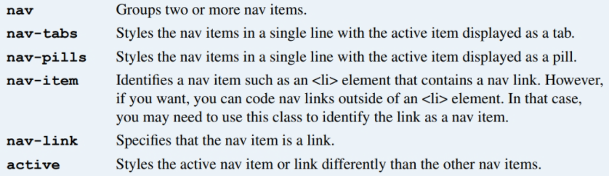
Common CSS classes for creating navs

Slide 33
Nav links styled as tabs
The HTML for the nav links
<nav class="nav nav-tabs">
<a class="nav-item nav-link active" href="/">Home</a>
<a class="nav-item nav-link" href="/products">
Products</a>
<a class="nav-item nav-link" href="/cart">Cart</a>
</nav>

Slide 34
The same nav links styled as pills
The HTML for the nav links
<nav class="nav nav-pills">
<a class="nav-item nav-link active" href="/">Home</a>
<a class="nav-item nav-link" href="/products">
Products</a>
<a class="nav-item nav-link" href="/cart">Cart</a>
</nav>

Slide 35
A more verbose way of coding the same nav links
<ul class="nav nav-pills">
<li class="nav-item">
<a class="nav-link active" href="/">Home</a>
</li>
<li class="nav-item">
<a class="nav-link" href="/products">Products</a>
</li>
<li class="nav-item">
<a class="nav-link" href="/cart">Cart</a>
</li>
</ul>

Slide 36
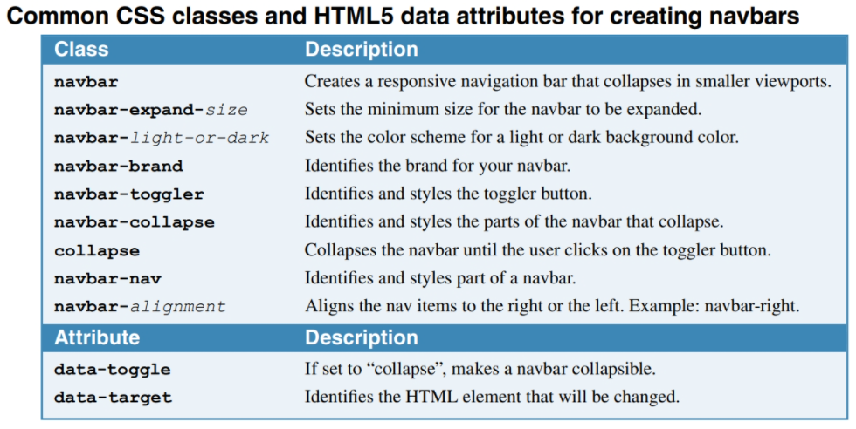
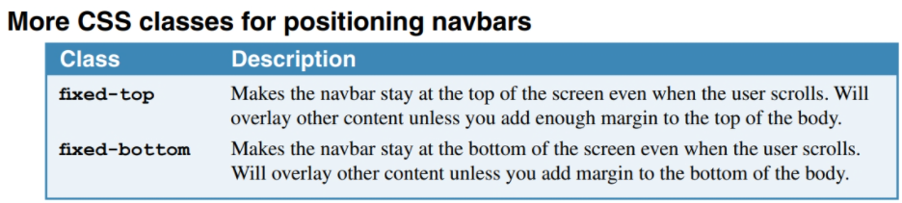

Slide 37
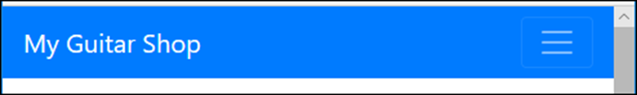
A navbar expanded on a wide screen
A navbar expanded on a small screen

Slide 38
The HTML for the navbar (part 1)
<nav class="navbar navbar-expand-md navbar-dark bg-primary">
<a class="navbar-brand" href="/">My Guitar Shop</a>
<button class="navbar-toggler" type="button"
data-toggle="collapse"
data-target="#navbarSupportedContent"
aria-controls="navbarSupportedContent"
aria-expanded="false"
aria-label="Toggle navigation">
<span class="navbar-toggler-icon"></span>
</button>
<nav class="collapse navbar-collapse"
id="navbarSupportedContent">
<div class="navbar-nav mr-auto">
<a class="nav-item nav-link active" href="/">Home</a>
<a class="nav-item nav-link"
href="/products">Products</a>
<a class="nav-item nav-link" href="/about">About</a>
</div>

Slide 39
The HTML for the navbar (part 2)
<div class="navbar-nav navbar-right">
<a class="nav-item nav-link" href="/cart">
<span class="fas fa-shopping-cart"></span>
&nbsp;Cart&nbsp;
<span class="badge badge-primary">2</span>
</a>
</div>
</nav>
</nav>

Slide 40
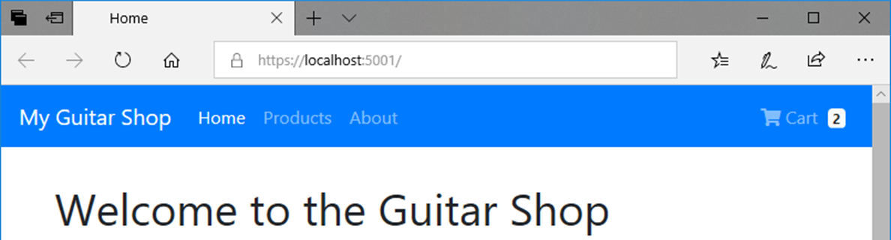
The HTML that displays the navbar
<body>
<nav class="navbar navbar-expand-md navbar-dark
bg-primary fixed-top">
<!-- navbar items go here -->
</nav>
<div class="container">
<!-- container items go here -->
</div>
</body>

Slide 41
Bootstrap
By Randy Daigle
PROG2230
ACSIT

Slide 42
Objectives
Define responsive web design and describe how it supports an optimal experience on a variety of devices
Apply client-side web development frameworks to develop responsive websites and apps

Slide 43
What is RWD?

Slide 44
What is Responsive Web Design (RWD)
RWD allows developers to create a website that can change its layout dynamically
Developers can therefore create a single design that works on multiple devices: mobile phones, tablets, PCs, etc…
That is, apps/sites designed responsively are generally fluid designs – that is:
They readjust themselves according to the size of the screen they are viewed in, and
Are also compatible with the touch interfaces of phones & tablets

Slide 45
For instance…
Using a sequence of images from the book “Jump Start Bootstrap” by Syed Fazle Rahma we can best illustrate the point
Suppose you had a blog-based web site/app that looked as follows on a PC (desktop/laptop):

Slide 46
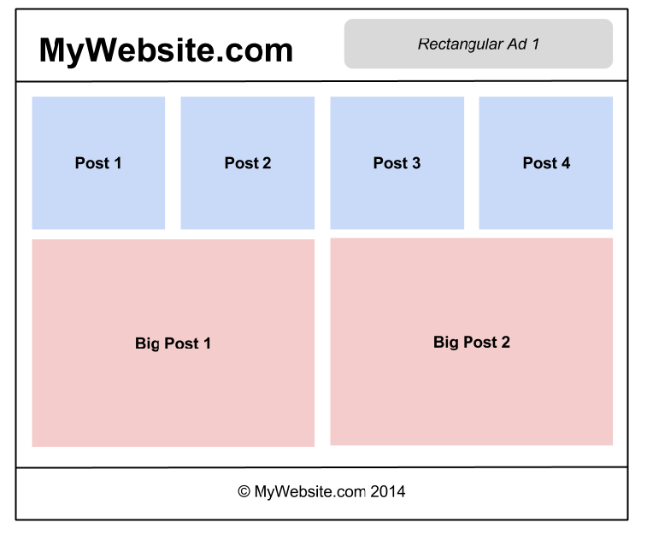

Slide 47
Which…
On a tablet we might want it to look like the following…

Slide 48
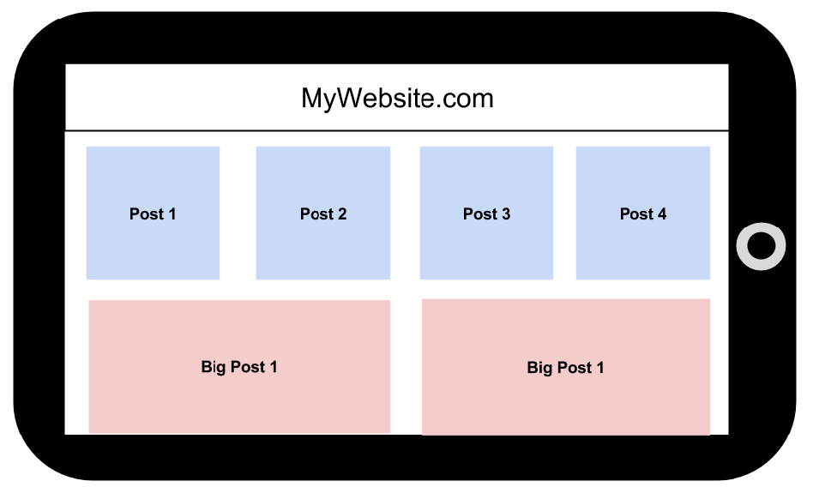

Slide 49
And…
On a phone we might want it at follows:

Slide 50
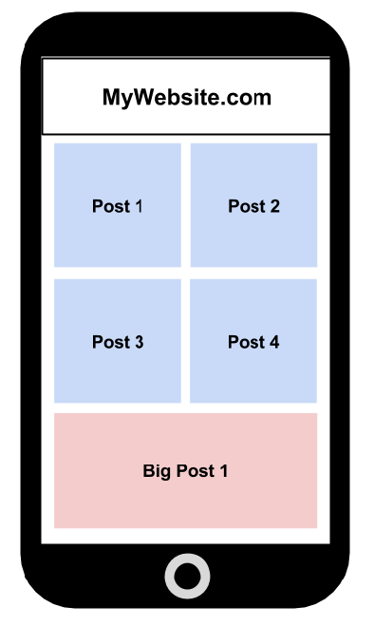

Slide 51
Here is another...
Reference that illustrates some key principles of RWD:
http://blog.froont.com/9-basic-principles-of-responsive-web-design/

Slide 52
Bootstrap: Introduction

Slide 53
What is Bootstrap?
From http://getbootstrap.com/, Bootstrap is:
“The most popular front-end framework for developing responsive, mobile first projects on the web.”
That is, Bootstrap is a client-side framework that supports RWD – i.e. the design and development of responsive web apps/sites
Created and open sourced by Twitter

Slide 54
A word of warning
Yes, Bootstrap is a framework that supports RWD…
But be under no illusion – RWD is extremely hard to do really well
i.e. to do well enough where your web site/app looks good and functions well on any device and screen size
So hard that some don’t even try – rather they develop a separate site/app for different devices
This path is only sustainable if all the heavy lifting is done on the server – e.g. via a RESTful service

Slide 55
Getting started
Let’s dive right into the HTML and CSS to get started
Here is the venerable “hello world” in Bootstrap that can hereafter serve as a starting template…

Slide 56
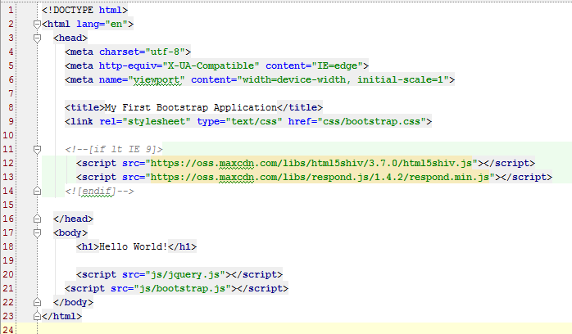
“Hello world” Bootstrap

Slide 57
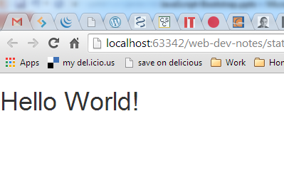
Which produces…
Note: the font of course is chosen by Bootstrap!

Slide 58
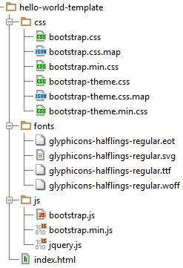
The file structure for this template
Let’s explore some of these files

Slide 59
A footnote:
If you want a sense of how complicated the work is that Bootstrap (and other CSS frameworks) does behind the scenes:
http://www.sitepoint.com/easy-responsive-css-grid-layouts/

Slide 60
Bootstrap: The Container

Slide 61
Bootstrap’s top-level containers
Bootstrap's grid system, which we’ll dive into next, allows you to specify rows and columns of your layout
But these rows and columns are contained within Bootstrap’s top-level container elements
These come in 2 forms:
Fixed width, and
Fluid width
Both have a left & right padding of 15px

Slide 62
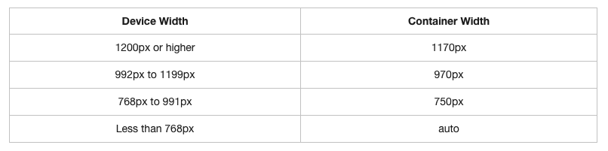
Fixed width containers
Have different fixed widths in different sized devices, as shown in this table:

Slide 63
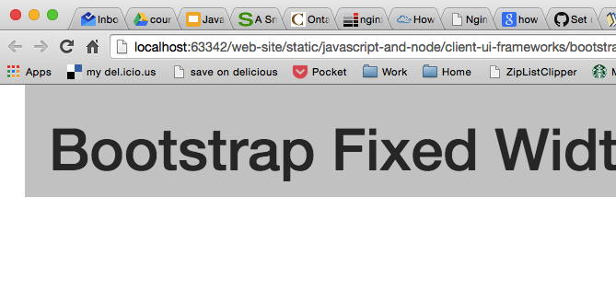
A fixed width example:
<div class="container">
<h1>Bootstrap Fixed Width Container</h1>
</div>

Slide 64
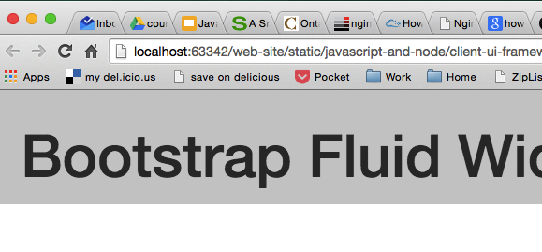
And a fluid width example:
<div class="container-fluid">
<h1>Bootstrap Fluid Width Container</h1>
</div>

Slide 65
Where...
Fluid-width containers do not have a fixed width
i.e. they are always the width of the device
So next…
What do we put in these containers?

Slide 66
Bootstrap: The “Grid System”

Slide 67
Bootstrap’s 12 column grid system
Bootstrap's grid system divides the screen into columns―up to a maximum of 12 in each row
The column widths vary according to the size of screen they're displayed in
i.e. the grid system is responsive - the columns resize themselves dynamically when the size of browser window changes
You can create any number of rows
The intersection of these rows and columns forms the grid to contain your site's content

Slide 68
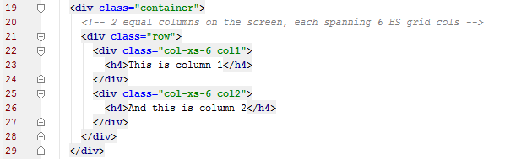
For example
As a first grid-based layout example:
1 row with 2 sections each taking up 6 columns of the grid
Bootstrap CSS classes
(more on “xs” later)
Our own CSS classes

Slide 69
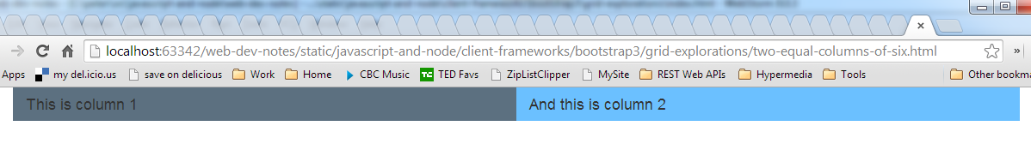
Which produces…

Slide 70
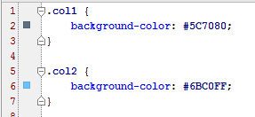
Note
Here we are style our columns in our own CSS file
i.e. outside the Bootstrap CSS files

Slide 71
Next, consider…
An example having two rows with each spanning a differing number columns

Slide 72
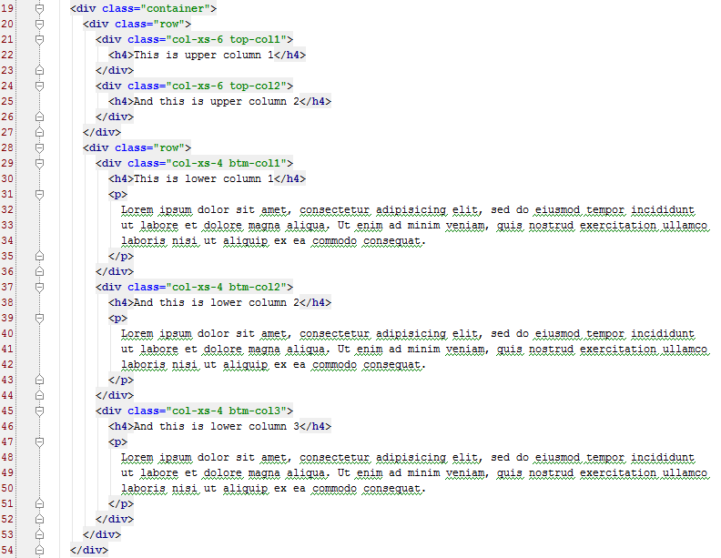

Slide 73
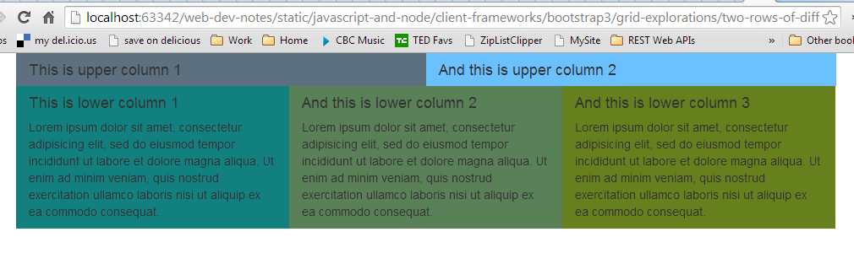
Which produces…

Slide 74
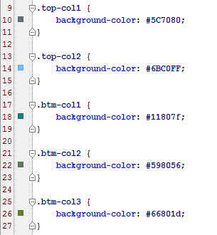
And here…
The CSS used is:

Slide 75
Bootstrap’s screen size codes
Bootstrap using the following size codes:
col-xs-
For extra small displays - i.e. screen width < 768px
col-sm-
For smaller displays – i.e screen width ≥ 768px
col-md-
For medium displays – i.e. screen width ≥ 992px
col-lg-
For larger displays – i.e. screen width ≥ 1200px

Slide 76
Think of these…
Codes (e.g. “xs”) as screen (or device) modes
Bootstrap is always based on a grid of 12 columns
Your job, potentially for each screen mode, is to specify column settings that declare how many of the 12 Bootstrap grid columns that you want a given content column to span on the screen
Let’s consider a first example that specifies settings for 2 different screen modes
In so doing we get our first glimpse into RWD!

Slide 77
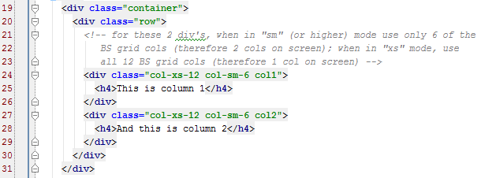
A first responsive layout
An example that displays 2 columns side-by-side except on very small screens (i.e. in “xs” mode) where they flow down the page:

Slide 78
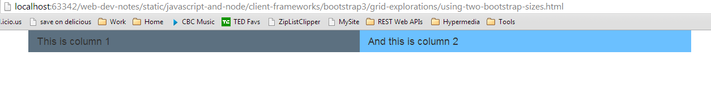
Which produces…
The following on say a desktop:
More precisely: anything in “sm” mode or above

Slide 79
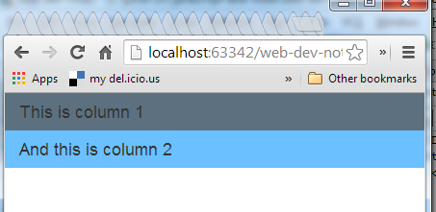
And…
The following when resized to “xs” size:

Slide 80
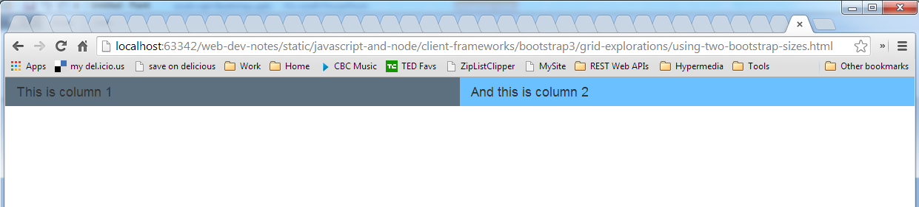
Or: using “container-fluid”…
We get the following on larger screens:

Slide 81
structural/layout row vs content row
This last example serves to highlight an extremely important concept, namely:
There can be 2 different meanings to “row” here
Bootstrap’s grid system defines a grid for structuring your layout
As such a row in Bootstrap is a structural layout row
It may turn out that there are multiple “rows of content”
As with the last example in xs mode

Slide 82
That is...
Here we have 1 structural/layout row and, in xs-mode only, 2 content rows:
structural/layout row
content row

Slide 83
That is…
In xs-mode:

Slide 84
And next
Let’s put these concepts to use to develop the layout for a blog-style web page that responsively adjusts its layout for different devices and screen sizes
To do this we set up the following:
3 columns of blog posts in “md” (or larger) mode
2 columns of blog posts in “sm” mode
1 column of blog posts in “xs” mode

Slide 85

That is, we have…

Slide 86

And…

Slide 87
And finally…
Just to convince that it really works, here is a photo of the same page being displayed on 3 of my devices: Chrome on my laptop, Safari on my iPad, and Chrome on my Android phone…

Slide 88


Slide 89
Extra Bootstrap Grid features
Before we leave the basics of the Bootstrap Grid system it is good to know about the following extra features:
Columns can be nested
Columns can be offset
Columns can be manually reordered
Let’s look at some basic examples making use of these features…

Slide 90
Nested columns
Let’s consider the following example…

Slide 91


Slide 92

Which produces…

Slide 93

Offsetting Columns
Jumping right to an example:

Slide 94

Which produces…

Slide 95

Pushing & Pulling (reordering) columns
Again, jumping right to an example:

Slide 96

Which produces…

Slide 97
Some wrap-up comments…
On the Bootstrap Grid system:
For offset, push & pull
There are of course versions for each screen mode: xs, sm, md, lg
It is really quite flexible
If you are creative enough, then you can pretty much define any layout within the constraints of this 12-column-based grid system

Slide 98
Bootstrap: Components

Slide 99
Now...
Once you have your layout figured out and specified with Bootstrap’s grid
What next?
You start placing things in the cells of your grid layout - what “things”? - e.g.
Text/image content
Bootstrap components

Slide 100
Let’s...
Explore some examples
It’s the best way to learn the components
I have placed all the code I am to demo in D2L
I strongly encourage you to play with the examples I have provided
However, before we explore the examples…
A few general comments...

Slide 101
Bootstrap’s naming convention
BS adheres to a common naming convention, namely:
what-it-is color-and-style [size-modifier]
For instance:
btn btn-danger btn-sm
Note: not everything has a size modifier

Slide 102
There are other style conventions
For instance, with panels, we get an example of a common Bootstrap theme:
panel-primary is dark blue
panel-success is green
panel-info is sky blue
panel-warning is yellow
panel-danger is red

Slide 103
So now...
Let’s explore the examples…
Which also includes 2 sample layouts we can explore
Also, as a quick aside:
These examples use a “non-root” URL referencing scheme
Why?

Slide 104
Bootstrap Resources
For a wide array of free Bootstrap templates…
http://www.bootstrapzero.com/
http://themes.getbootstrap.com/
Nice dashboard template:
http://demos.creative-tim.com/light-bootstrap-dashboard/dashboard
And are you sure you want/need Bootstrap?
If not, then this might help you decide:
http://blog.creative-tim.com/web-design/use-not-use-bootstrap-framework/

